Slide 1
MD Simulation of GFP Protein Under Different Conditions
Jack Ustanik

Slide 2
MD Simulation
Computational method which provides simulations that show the motion and interaction of atoms and molecules in a structure over a given period of time
At a particular times step (femtosecond) new positions of atoms are determined
With the force field MD can calculate force on atoms, acceleration, and predict new locations of atoms
Simulations typically last for an amount of time until convergence can be reached: calculated using RMSD values - more complex structures and longer simulations take longer to occur and require more computational power

Slide 3
Why Preform MD Simulation?
Prediction of how atoms in a protein or molecular system will move over time based upon laws of physics and interatomic interactions
Controlled Environment
Can determine conformational changes, ligand binding, protein folding, and reveal positions of atoms
Drug design, optimize conditions, behavior of biological systems

Slide 4
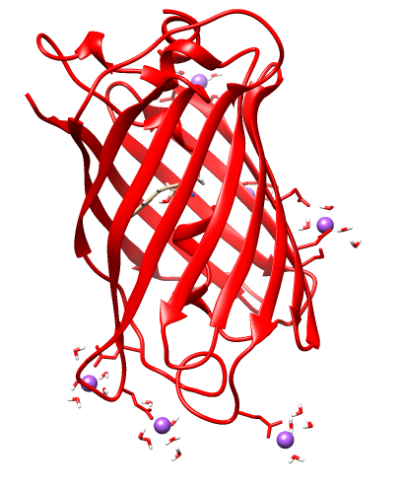
MD simulation of GFP using AMBER
Starting off with energy minimized form of GFP protein
Prepares the structure for MD simulation by providing an energetically favorable structure
Ridding structure of clashes and forming optimal interactions
Add heat to the system
Equilibration: Alter conditions to align with preferred MD values
MD: We are investigation 5 conditions and seeing how altering a particular parameter impacts the MD simulation: Normal, No energy minimization, cut = 5, dt = 0.01, dt = 0.005

Slide 5
Parameters
cut (Cut Distance): Distance between atoms which will be involved with interactions in an MD simulation
Too Small? Too Large?
dt (Time Step): Time interval which calculations occur in an MD simulation
Too Small? Too Large?
noEmin (no energy minimization): No energy minimization has occurred
Altering these parameters can produce different MD simulation outcomes

Slide 6
Parameters for MD Simulations
heating.in
cut = 8.0,
ntr = 0,
nstlim = 25000, dt = 0.002,
dt = 0.005
dt = 0.01
cut = 5.0
equi.in
cut = 8.0,
nstlim =50000, dt = 0.002,
dt = 0.005
dt = 0.01
cut = 5.0
md.in
cut = 8.0,
nstlim = 2000000,
dt = 0.002,
dt = 0.005
dt = 0.01
cut = 5.0
Energy minimization
-c ../../Lab1_GFP_energy_minimization/gfp_min_all.rst7 \
-ref ../../Lab1_GFP_energy_minimization/gfp_min_all.rst7 \
No Energy minimization
-c ../../Lab1_GFP_energy_minimization/gfp.rst7 \
-ref ../../Lab1_GFP_energy_minimization/gfp.rst7 \

Slide 7
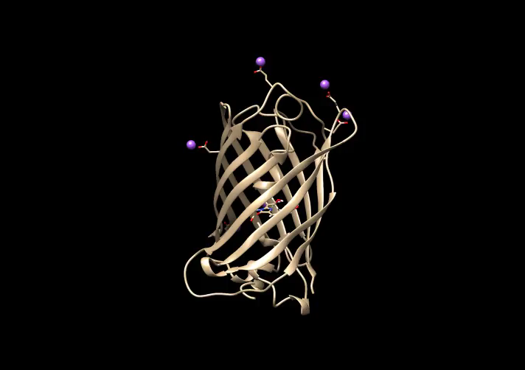
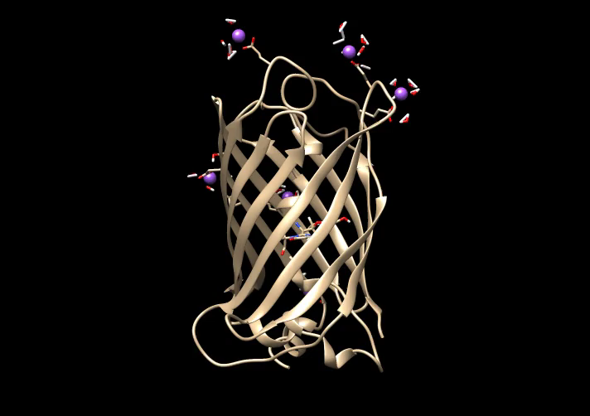
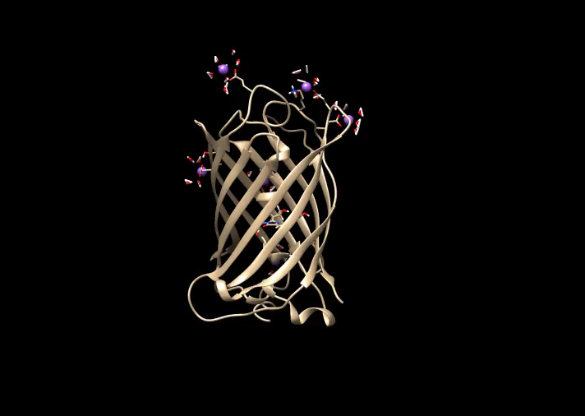
Simulations
Heating, Equilibrium, MD of Normal and Cut5
What happened to the others?

Slide 8
Failures
Total Energy Kinetic Energy Potential Energy
dt_0.005 failed at step 21.5
noEmin failed instantly
dt_0.01 failed instantly
ETOT | EKTOT | EPTOT
-126810 (-117388) | 3592 (8568) | -130402 (-125957)
ETOT | EKTOT | EPTOT
353586 (-153457) | 520 (527) | 353066 (-153984)
ETOT | EKTOT | EPTOT
-153461 (-153457) | 522 (527) | -153984 (-153984)
Kal/mol

Slide 9
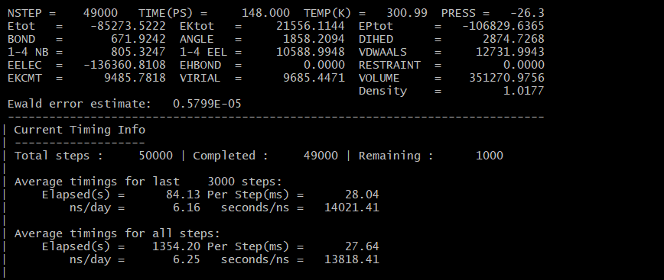
MDINFO Values
Cut5 and Normal values were very similar
NoEmin, dt_.005, dt_.01 values much different

Slide 10
Data
The normal and cut5 setups were the only 2 simulations which finished successfully
No Energy minimization, dt.01 and dt.005 each failed
Plotted are total, potential, and kinetic energy for each system
Trends?

Slide 11
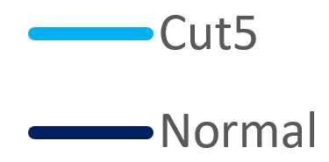
Data Continued
Trends?

Slide 12
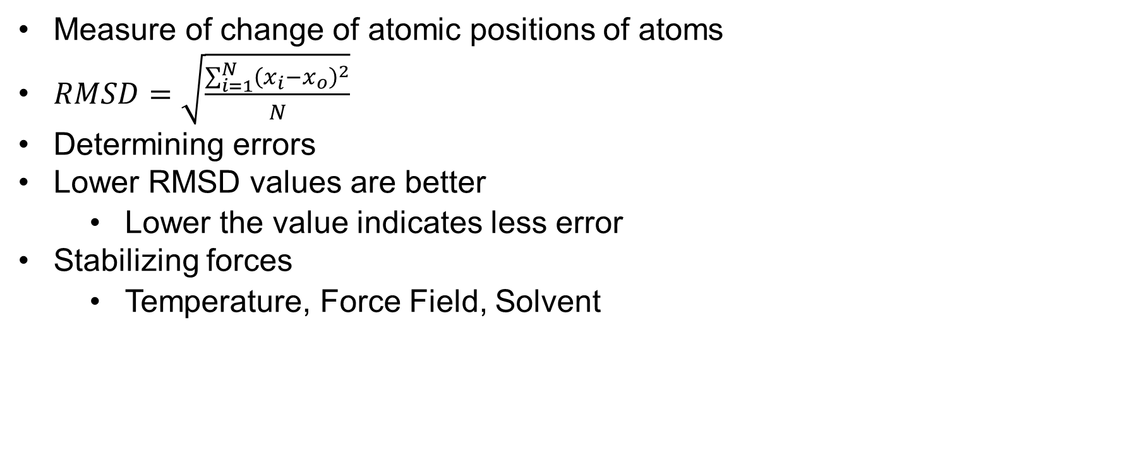
Root-Mean-Square Deviation (RMSD)
Measure of change of atomic positions of atoms
$RMSD=\sqrt{\frac{\sum_{i=1}^{N}{{\left(x_{i}−x_{o}\right)}^{2}}}{N}}$
Determining errors
Lower RMSD values are better
Lower the value indicates less error
Stabilizing forces
Temperature, Force Field, Solvent

Slide 13
RMSD plots

Slide 14
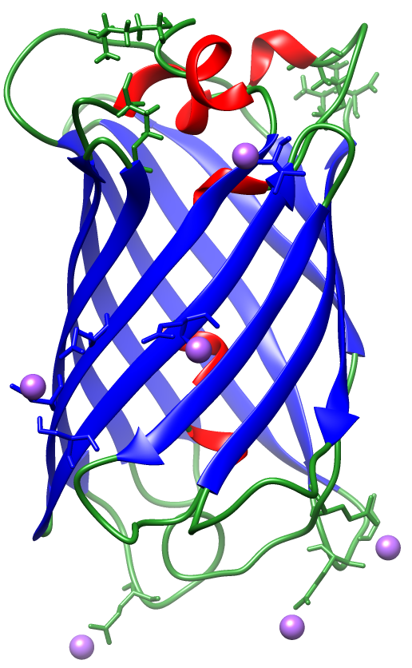
Take Away
AMBER software and chimera are valuable tools for observing energy minimization
MD simulations allow us to understand more of structures
Various parameters impact MD simulations
Cut, dt_.01, dt.005, noEmin
RMSD values are useful for assessing structures

